Slide 1

My Virtual Fridge
Group 17

Slide 2
Project Goals & Objectives:
The purpose of MVF is to pro-actively manage consumers’ food waste while providing them with information to raise awareness.
We are aiming to produce a functioning application that will allow consumers to search for recipes, with specific or left-over ingredients, and have a dashboard consumers can interact to manage their inventory.

Slide 3
Tasks
For the first week, we as a group were researching ideas for the application.
The second week we mainly focused on coming up with a UI that would best suit the application; Also, we’ve done research on what languages/databases would work best for our needs.
The third week is focusing on building the skeleton of our application and getting started on our database.

Slide 4
Deliverables:
Sprint #1: An interactive application with a friendly user UI and a functioning dashboard
Sprint #2: A completed responsive database implemented into the application
Sprint #3: Notification and achievement functions with overall cohesiveness check

Slide 5
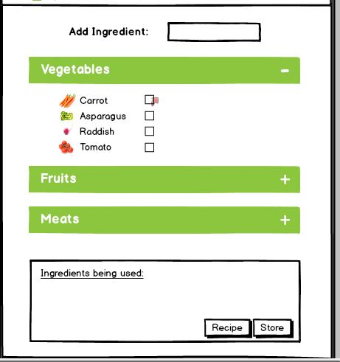
Friday’s Presentation Feedback
The most common feedback we’ve received from the groups is that our font and checkbox, for the layout, is small and we’re aiming to fix that this week.

Slide 6
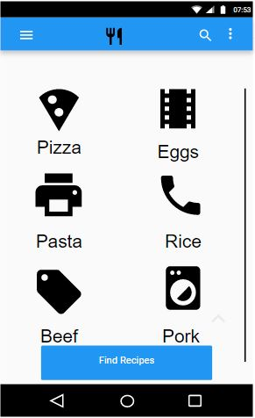
Possible solution to the problem
The one idea we have right now is having icons that would add to the ingredients list instead of the checkbox.

Slide 7
Affiliated Applications
Application | Group Number | Description
Waste | 23 | An App to track food usage/wastage
Pocket Pantry | 8 | A meal planner & grocery list
WhatsInMyFridge? | 1 | A website that keeps track of when your food expires
EcoList | 10 | Grocery list and meal planner
Meal.io | 29 | App to help families manage the food in their lives

Slide 8
In Conclusion:
We aim to seek out consumers during an active mindset to fulfill their wants while directly, and indirectly increasing their level of food waste awareness.
Any questions?

Slide 9
My Virtual Fridge

